Slide 1
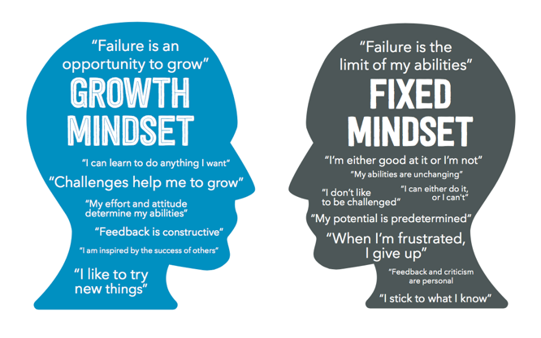
Growth Mindset
Growth Mindset Video
Know the tortoise and hare story? All students saw this in x-time last week, and we spoke with them about the teenage brain and #growthmindset using this classic story. We had a great discussion with our students about perseverance. We are so proud of our students already this year. #bestyearyet #101alag #rotolo25

Slide 2
Seventh Grade X-Time Information
X-Time is connected to lunch for 7th graders
Focus on student’s greatest area of need
Focus on Social Emotional Learning and Academic Growth
Review student achievement several times a year as a team
Flexible groups for students (cycling every 5-6 weeks)
Interventions and enrichment will occur
Staff will focus on a growth mindset with students

Slide 3
Parent Teacher Conferences
Conferences available 12:00-8:00 on October 6
15-20 minute time slots
Goal remains to meet with all parents who would like a conference
Conference window October 3-14
Parents may contact teachers for conference beginning September 6
Teams or individual teachers may contact you for a conference as the process may vary

Slide 4
Coffee with the Principal &
Parent Advisory Committee
Meets on each half day of the school year from 10:00-11:00 in the LRC
September 2
October 6
November 11
March 2
April 14
Discussion Topics Include:
Curriculum
Social Emotional Learning
Growth Mindset
Middle School Transition
School Communication
Staff Hospitality
Parent Involvement
Extra-Curricular Opportunities

